Slide 1


The Chilly Dog Sponsor Skyelar Head TA Sambandh Dhal Group Members Grant Franklin Martin Rennaker Yarentzy Magallanes

Slide 2
Problem Description
Problem statement:
Temperatures inside vehicles during Texas summers can be very dangerous for pets.
A car parked outside on a sunny, 95-degree day can reach temperatures of up to 117 degrees Fahrenheit in just 30 minutes.

Slide 3
Solution Description
Solution proposal:
The Chilly Dog is a battery powered car A/C system
Provide a way to cool down the internal temperature of the car, while being able to adjust the desired temperature using a phone application.

Slide 4
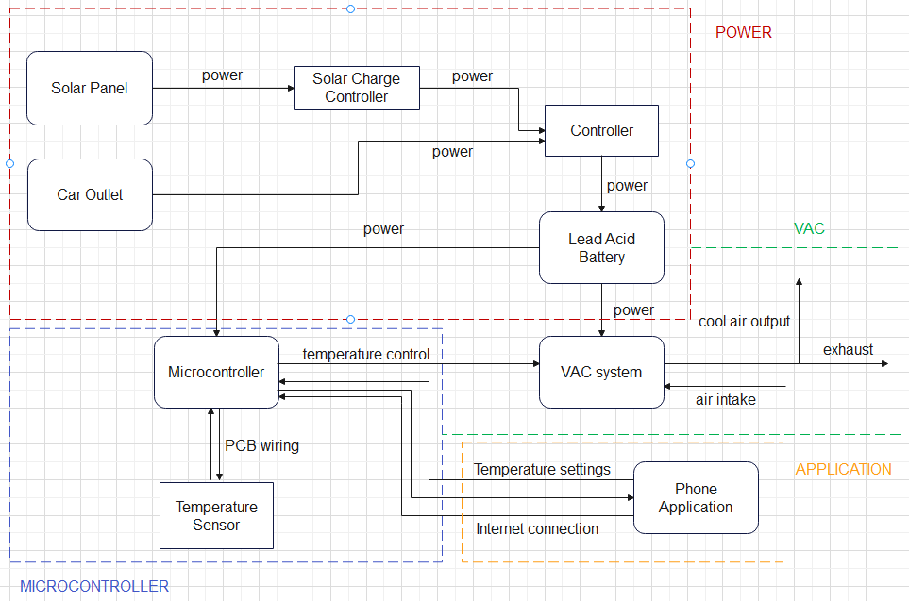
Subsystem Block Diagram
Grant
Yarentzy
Yarentzy
Martin

Slide 5
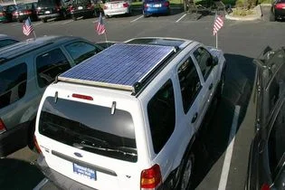
Power Supply
Charging:
15W, 12V solar panel
12V car outlet
Mux controlling input
Power source:
12V, 100Ah Sealed Lead Acid Battery
Will be scaled up and down to power MCU and VAC subsystems
Source: jalopnik.com

Slide 6
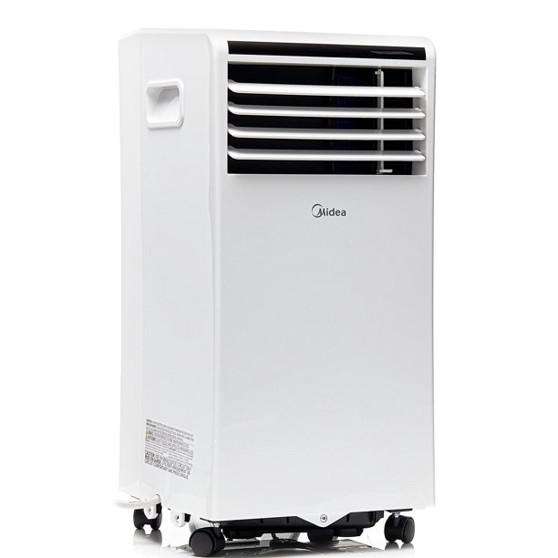
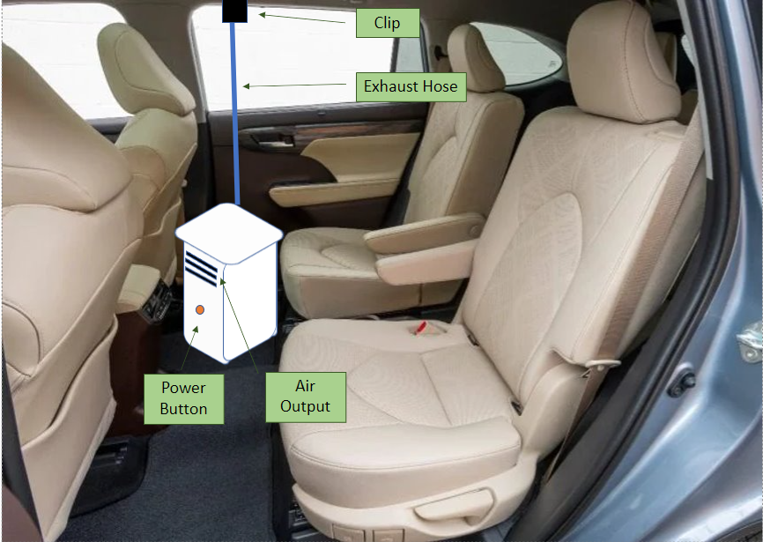
VAC System
Midea
Key Features
115V
5,000 BTU can cool 150 sq ft
3 modes: Low, Mid, High
Bonus Features
Size 12.56"x24.96"x12.96"
10.5 CEER rating
Notes:
The Air Conditioning Unit we chose for the functionality of the chilly dog was the Midea Comfortsense.
The key Features that led us to our decision revolved around the power consumption of 115V meaning it is compatible with virtually any wall outlet. the cooling capacity. Or the BTU which stands for British thermal unit. Is 5,000 as can be seen here. With 5,000 BTU we are able to cool 150 sq ft This was important because We are aiming to cool a crossover vehicle which on average span 100 square feet. The modes of Low Mid High and Auto were also taken into consideration as the MCU will determine the intensity of the air output depending on the ambient temperature. We will dive deeper into this on the following slide.
The features listed above tied directly to our subsystems however these bonus features were also important. The Chilly Dog will be installed into the cabin of the customers vehicle and take up no more than one seat. These measurements satisfy that specification. The CEER which is a rating set by the department of energy describes the efficiency of the unit. The higher this number is the more efficient the unit is. Here we have a 10.5 out of 14. We are in good shape.
The midea comfortsense will provide the perfect climate for your furry friend.

Slide 7










Microcontroller
Power
Application
Setpoint
VAC
Sensor
Notes:
The microcontroller of the Chilly Dog will be the brain of the device.
It will receive inputs from the power subsystem. 1 functionality being choosing whether the battery will receive its charge from the solar panels or the cigarette lighter outlet. As well as receive the percentage of the battery charge.
It will receive inputs from the ambient temperature sensor This sensor will report the internal temperature of the cabin Actively and accurately to then output that reading to the users application. The microcontroller will then receive the desired temperature set by the user on the app and output the proper air flow to meet those specifications. It will continue this process of checking the ambient temperature comparing it to the setpoint until either the desired temperature is met or the device is turned off.
For this we will be using a PIC18 for the hardware and its supporting software MPLAB.

Slide 8
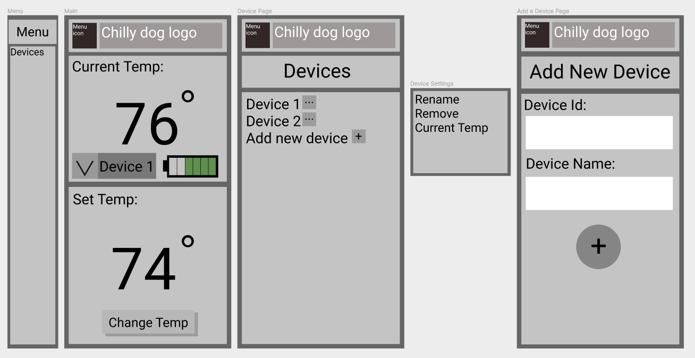
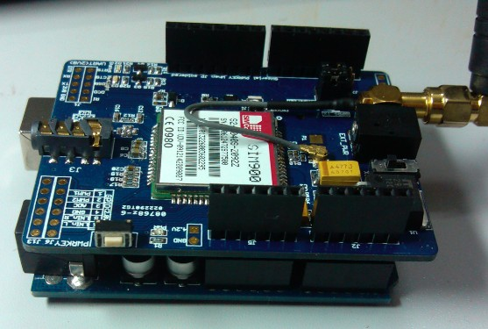
Phone Application and Modem
Send user’s desired temperature to microcontroller
Receive current car temperature and current battery percent
Display both to user
Allow user to change the desired temperature at any time
Allow the user to have and manage multiple devices
A mock-up of the app
GSM/GPRS
Shield V1

Slide 9
Validation and Execution plan
Subsystem | 2/21 | 3/7 | 3/21 | 4/4 | 4/18 | 4/25
Power Supply | Simulate power system and order components for MCU | Begin testing power components and finish writing software for MCU | Begin putting full circuit together and validating outputs | Continue validation testing for full circuit | Ensure full circuit is in working condition and passes all validation | Subsystem presentations
MCU | Program a "Hello, World" | Configure MCU and ambient temperature sensor | Establish connection between AC and MCU | Accept input from application (SPI) and incorporate into AC controls | Finalize scope of microcontroller | Subsystem presentations
VAC | Receive unit and familiarize use | Obtain access to the control functionalities of the VAC | Test MSU commands and assure expected output | Design exhaust clip utilizing SolidWorks | Finalize and test compatibility With MCU | Subsystem presentations
Phone App | Make an app layout, find and order a cellular modem | Begin testing of the cellular modem and make sure connection is possible. Make connection to modem with an android app | Validate that app can transmit and receive data it needs, and output it correctly to MCU | Implement the app GUI over the already constructed app backend | Validate the app and modem are working properly together | Subsystem presentations

Slide 10
Part Order Status
Part Description | Status (order approved/order placed/part received)
DC-AC Inverter | Order approved
SIM card | Order approved
Midea Air Conditioner | Order approved
PIC MCU | Order approved
Notes:
Here is a list of oour preliminary parts list. We are on scheudle and can excpect to recive all of out components

Slide 11
Summary
We are creating a battery powered car a/c to keep pets safe in Texas heat.
Our design will consist of a VAC system and a microcontroller that controls it, where the user can input their desired temperature in the app.
Notes:
We are currently putting the finishing touches on the FSR and ICD as well as the Validation and execution plan. We have visited the university writing center to review our papers and practice our presentation. As we wait to receive our parts we will continue learning as much as we can about our subsystems. But we are really excited to start getting our hands dirty in implementing our design and seeing our thoughts come into fruition.

Slide 12

Questions?

